Slide 1

PLANNING IN LAPEL
C2 District Parking Requirements
July 2025
Prepared by: Marcellus Johnson

Slide 2
Contents
C2 Zoning District Intent
C2 District Map (Annotated)
C2 Parking Requirements
C2 Parking Design Standards
Parking Requirements Conformity
Existing Off-Street Parking
Existing On-Street Parking
Further Recommendations
References and Further Reading

Slide 3
C2 Zoning Intent
The “C2”, Downtown Commercial District is intended to provide for the continued viability of the historic central business district. This district is also intended to accommodate and support the use of existing structures within the downtown. It is further intended to permit the continued, contextually appropriate, development of the area through re-use, infill, and mixed-used development.

Slide 4
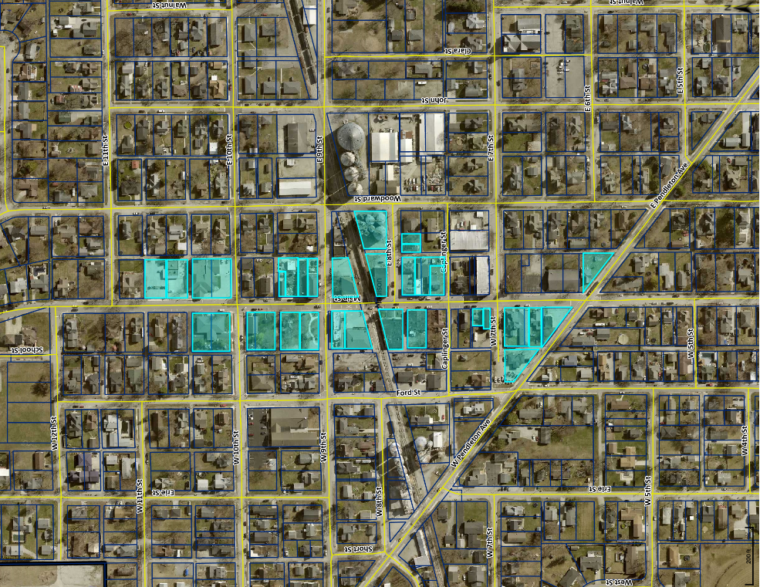
C2 District Map
N <
Includes:
28 buildings
21 businesses
11 residences
1 park
1 parking lot
State Bank
Smoky’s
Lapel Bulldog
Town Hall
Post Office

Slide 5
C2 Parking Requirements
V7.2.15. Parking Standards
    1.5 off-street spaces per dwelling unit and 1 visitor parking space for every 2 units
    1 off-street space for every employee working the longest shift (FTE)
    0.5-1 off-street space for each business vehicle on site
    0.5-1.5 off-street spaces according to square footage/seats in an auditorium or dining room

Slide 6
C2 Parking Design Standards
V7.2.15. Parking Standards
    Parking lots must be paved and spots clearly marked with paint
    Parking spaces shall be placed so that they do not require vehicles to maneuver in a public ROW or entrance drive
    Parking lots must be fully curbed and have wheel stops as necessary
    Parking lots must have lighting and landscaping (if 6 or more spaces)

Slide 7
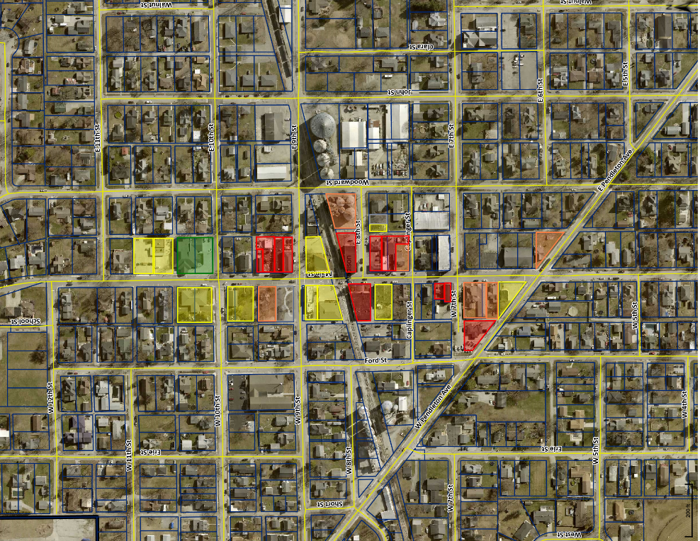
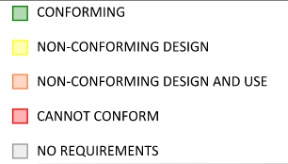
Parking Requirements Conformity
N <
Current C2 Zoning would require a minimum of 287 off-street spaces. When the required parking stall and drive aisle dimensions are included, this would amount to over 115,000 sf.
State Bank
Smoky’s
Lapel Bulldog
Town Hall
Post Office

Slide 8
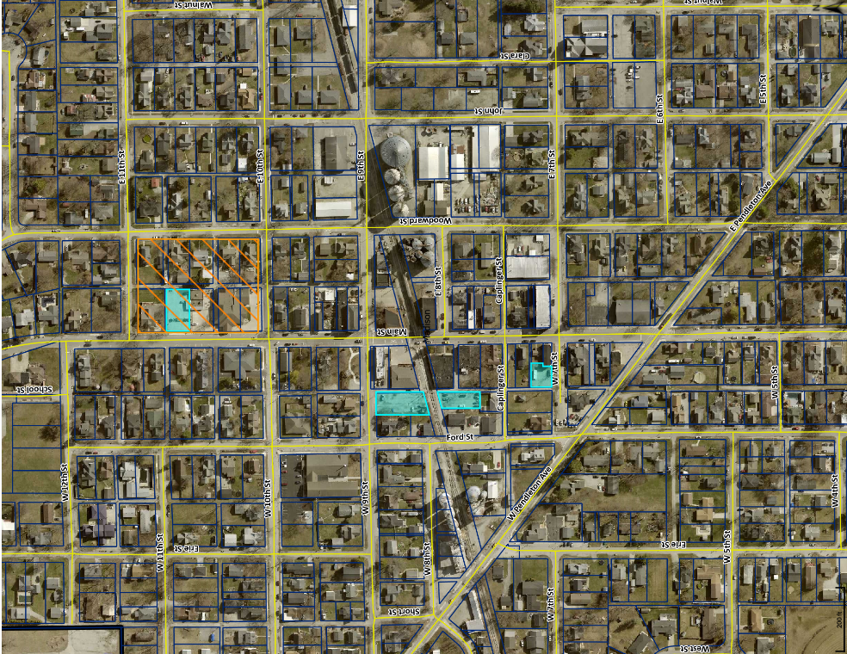
Existing Off-Street Parking
N <
Currently vacant parcels used for parking (cyan) total about 33,976 sf, which is only about 1/3 of the estimated space needed to bring all existing buildings into conformity (orange).
Smoky’s
State Bank
Lapel Bulldog
Town Hall
Post Office

Slide 9
What can be done to better align parking standards with zoning intent?

Slide 10
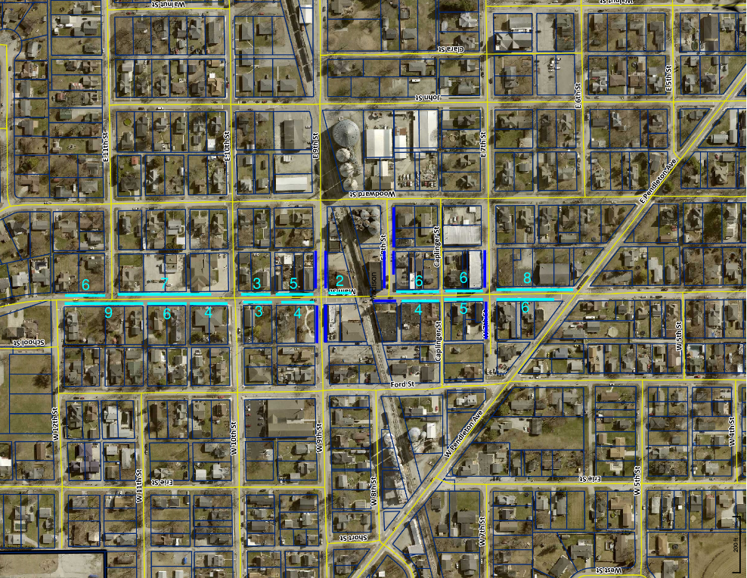
Remove Off-Street Parking Minimums
N <
On Main Street, there are already 84 marked on-street spaces with space in the rights of way on either side to add around 36 more marked and properly paved/maintained spaces.
For standard operations, existing on-street parking is sufficient to meet current demand, and it is unnecessary to require new businesses to provide additional off-street spaces.
Smoky’s
State Bank
Lapel Bulldog
Town Hall
Post Office

Slide 11
Further Recommendations
Allow on-street parking to be factored into required parking
“In lieu” fees – charge applicants for each spot they don’t provide
Fees could be set aside to fund road maintenance or maintenance of on-street parking
Loosen design standards and encourage greater use of alleys

Slide 12
References and Further Reading
  Best Practices: Parking Management & Design. Des Moines Metropolitan Planning Organization
  Planning for Whole Communities Toolkit – Parking Management. Puget Sound Regional Council
  Parking Policy Innovations in the United States. Urban Land Institute

